Slide 1
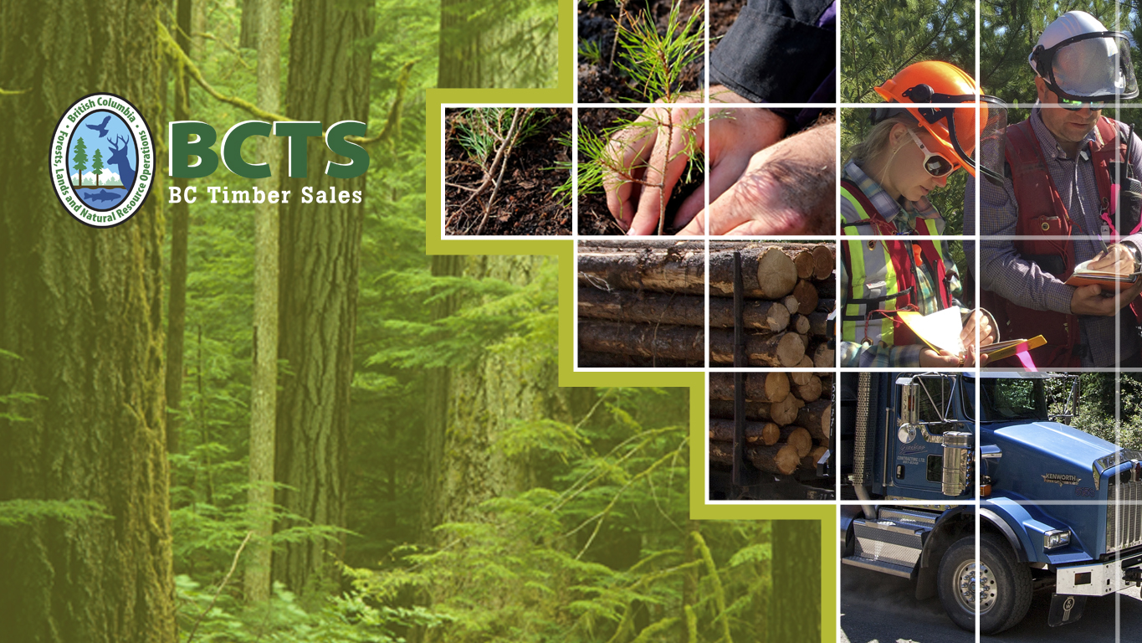
Growing Success in B.C.’s Forest Sector

Slide 2
The Jargon of Forestry
A detriment to working with the public and FN.
Hold our feet to the fire …….. demand the Kings English!
1 cubic meter = one telephone pole.
1 highway log truck packs 35 m3 give or take.
We can only cut what we grow – sustainability.
Timber Supply Area (TSA) administrative unit to calculate an annual allowable cut (AAC).
Tenure = type of license to harvest or build roads or both.
Silviculture = the art of managing tree growth from seed to cut.

Slide 3
BCTS – WHY ????
Consistent, accountable, transparent governance.
Withstand the scrutiny of legal challenges.
Collect sound data to set stumpage rates across the province.
Support the Softwood Lumber Agreement file.
USA biggest softwood lumber trade partner.

Slide 4
Why in our backyard?
The land use issues are complex ………..
How much working forest, how much park, how much room for population expansion, mineral, gas, hydro ……….?
Societal expectations …………?
Indigenous peoples expectations ………….?
BCTS is assigned operating area and apportioned a level of cut. We have minimal influence and must be seen as honest brokers. We can re-design, delay, trade or walk away…….but

Slide 5

BABINE
About BC Timber Sales - The How?
Stand alone government agency
within FLNRORD.
20% of the total Provincial AAC and operating area.
LEAN headquarters team and > 600 staff in operational delivery centres throughout B.C.
Reliable source of timber for independent mills and market loggers.
Operates similar to a major forest company (planning, development, roads, silviculture) …… mimic industry.
Notes:
BC Timber Sales (BCTS) is a self-financing program within the Ministry of Forests, Lands, Natural Resource Operations and Rural Development.
BCTS supports the Ministry’s vision of environmental sustainability and economic prosperity and has an integral role in supporting the Forest Sector Strategy in the BC Jobs Plan.
It also supports the Ministry’s three Goals:
Efficient, citizen-centred public service delivery
Co-ordinated sustainable management of British Columbia’s natural resources
Productive, thriving natural resource sector and resilient communities

Slide 6
BCTS Core Goal & Objectives - The How?
To provide a credible representative price
and cost benchmark data for the market pricing system (MPS) through auctions of public timber:
  Sell the full BCTS apportionment over the business cycle 5yrs, consistent with safe practices sustainable forest management;
  Generate net direct revenue and indirect provincial government revenue over the business cycle (not about profits it’s about data);
  Pursue continuous business improvement within BCTS, across government and with third party partners and customers.
Notes:
BCTS provides these benefits by planning, developing and selling through auction a substantial and representative portion of the Province’s annual available timber volume as well as reforesting harvested areas.
The bid prices received from auctioned timber support the Market Pricing System (MPS) in setting stumpage rates for most non-BC Timber Sales cutting authorities throughout the province.
The costs incurred by BCTS also provide data for the Tenure Obligation Adjustments, contributing to another integral part of the MPS.

Slide 7
BCTS Operations
12 business areas with main offices and field
offices in 33 rural communities.
Contracts with local service providers for:
  Operational planning and analysis;
  Cruising and cut-block layout;
  Engineering and constructing roads and bridges;
  Silviculture (site preparation, planting, brushing).
Notes:
BCTS maintains presence across the province and with 20% of the provincial AAC and operating area. I
t is the largest forest management entity in BC.
In addition to conducting BCTS operations, we can also provide fee-for-services via contracts to other licence holders (First Nations and communities) through B2B agreements, and market their timber through disposition agreements.
This helps integrate BCTS with the communities and helps develop local capacity and expertise in all aspects forest management.

Slide 8
BCTS Performance – The What?
BCTS sold 12.7 million m3 of timber in 2016/17.
Since 2003 BCTS has sold over 162 million m3 of timber, earned over $800 million in net revenue and generated $300 million of indirect revenue.
The development, auction, harvesting and processing.
of this timber has created and sustained over 8,000 direct jobs.
It is estimated that this has also led to 10,000 indirect jobs, supporting BC families and rural communities.
Notes:
BCTS supports the provincial government and the Ministry as major contributors to the current and future economic health of the Province.
In 2016/17 earned $158.2 million in Net Revenue supporting the government’s fiscal plan and priorities.
BCTS directly contributes to the Ministry’s objective that economic benefits of natural resource development are optimized.
BCTS operates under a self-financing special account and must generate sufficient revenue to finance its cash requirements (i.e. earn a profit) over the long term.

Slide 9
2016/17 Chinook Performance
Sold 840,000m³ of timber in the Business Area
(Chilliwack, Squamish, Haida Gwaii, Powell River).
Planted million 1.1 million seedlings to meet Chinook
reforestation obligations – LEGAL REQUIREMENTS
Constructed 6.9 km of new road.
Maintained Sustainable Forest Management certification on 100% of the operating area (third party oversight, audited regularly)
We are SAFE Company certified:
  100% of parties working on TSLs must be SAFE certified companies
  All BCTS contractors and subcontractors must be SAFE certified
Notes:
In 2016/17 BC Timber Sales:
•Sold 12.7 million cubic metres of timber supporting the Market Pricing System, rural economies, jobs and families.
•Delivered on our stewardship obligations by growing seedlings for BCTS and other Gov’t planting obligations and planting trees on BCTS harvested sites.
•Supported Productive Future Forests by provided 25 million seedlings and planting 11 million trees for the Forests for Tomorrow program.
•Maintained 100% of our operational area certified under a Sustainable Forest Management system demonstrating sound forest management.
•Maintained our SAFE Company certification supporting forest sector safety.

Slide 10
Timber Sale Auction Design
World-leading experts in auction design
(Market Design Inc.) advised the ministry
on MPS
MPS auction design ensures that:
  Winning bids represent competitive market prices;
  Auctions are transparent and open;
  Auction rules and procedures follow industry “best practices”;
  Auctioning 20% of Provincial AAC establishes valid comparisons with timber harvested under other tenures;
  BCTS program size is sufficient for estimating the average market prices of all harvests from long-term tenures.
Notes:
Regarding the auction volume, the original design work by MDI had specific goals that the design of the system should achieve:
The estimated prices have sufficient statistical precision
The market is sufficiently thick (sufficient number of participants)
Problems of strategic bidding is avoided
The work indicated that potential problems with statistical precision, market thickness and strategic bidding can be addressed by auctioning volumes of at least 15% of AAC.

Slide 11
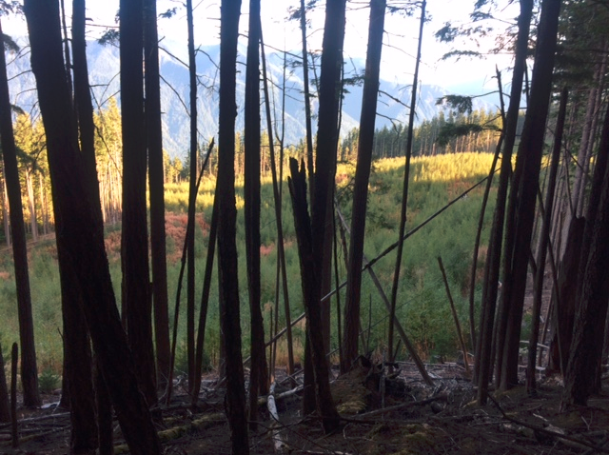
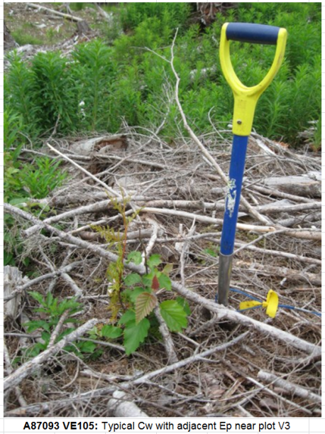
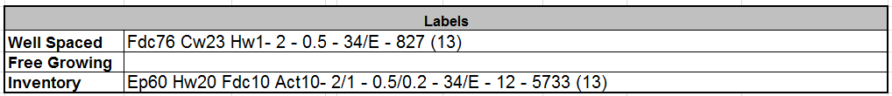
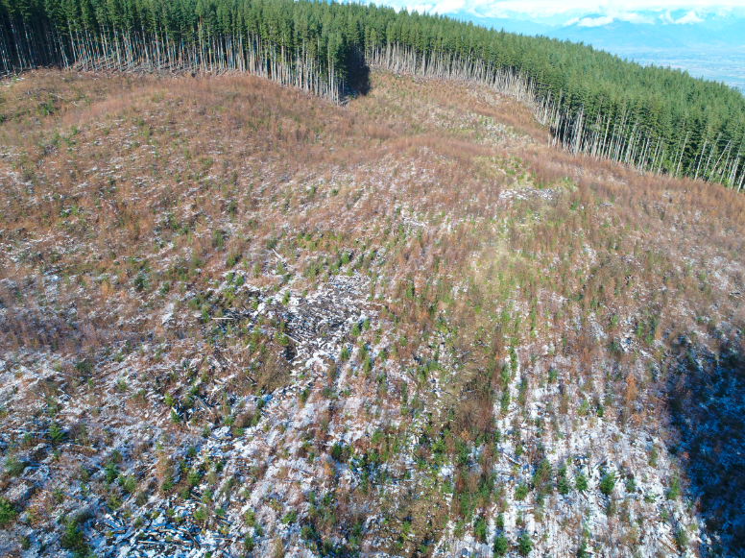
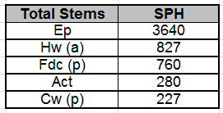
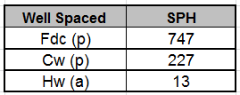
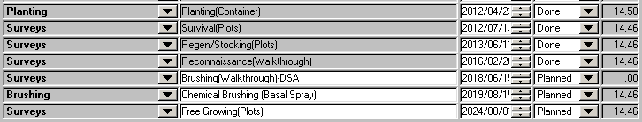
Block VE 105 – brushing plans
Results of 2013 regen survey
Cw 2013 photo
Dave Clyne’s photo
Schedule of Silviculture treatments for VE105
Note: form of treatment is under consideration and may be switched to manual brushing
Drone photo VE105 Nov 10, 2017

Slide 12

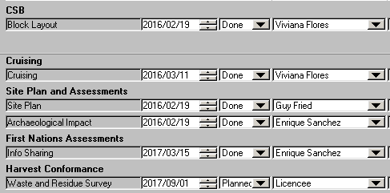
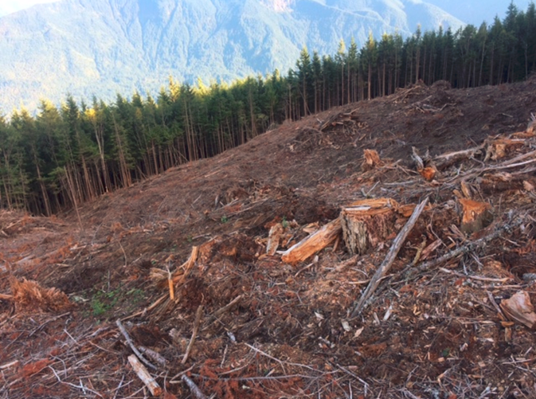


TSL A92172 VE116 Planning

Slide 13
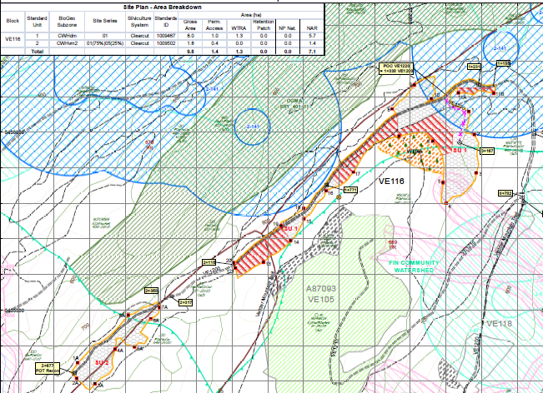
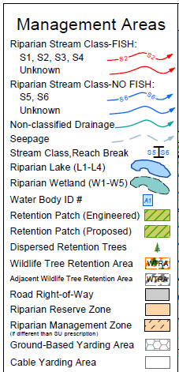
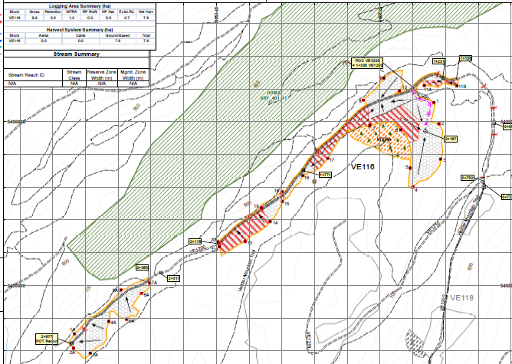
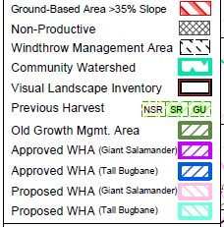
TSL A92172 VE116 Planning

Slide 14
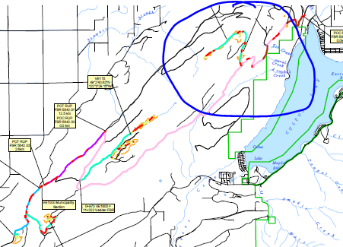
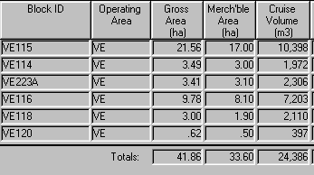
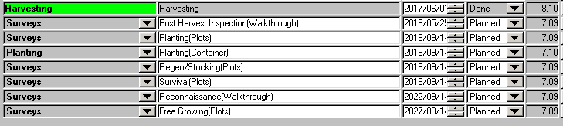
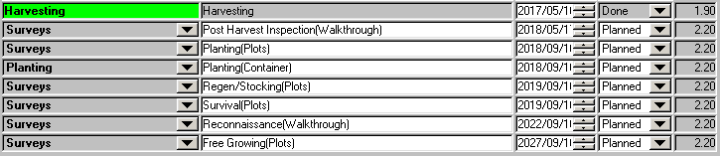
TSL A92172 Silviculture
TSL A92172 Blocks, area, volume
Silviculture plan for VE116
Silviculture plan for VE118

Slide 15
Our BIGGEST Challenges
Meeting First Nation Expectations for Reconciliation
Species at Risk - hot spots like Chilliwack and Sunshine Coast
Social License - uphill in bare feet

Slide 16

Workshop Scope and Intended Outcomes

Slide 17
The BCTS Mandate and Mission
Mandate:
Set cost and price benchmarks for timber harvested from public land.
Mission:
Committed to pursuing excellence in all aspects of our business, maintaining effective relations and focusing on results, BC Timber Sales generates economic prosperity for all British Columbians through the safe, sustainable, and reliable development and auction of Crown timber and by playing a pivotal role in the ministry’s reforestation strategies.

Slide 18
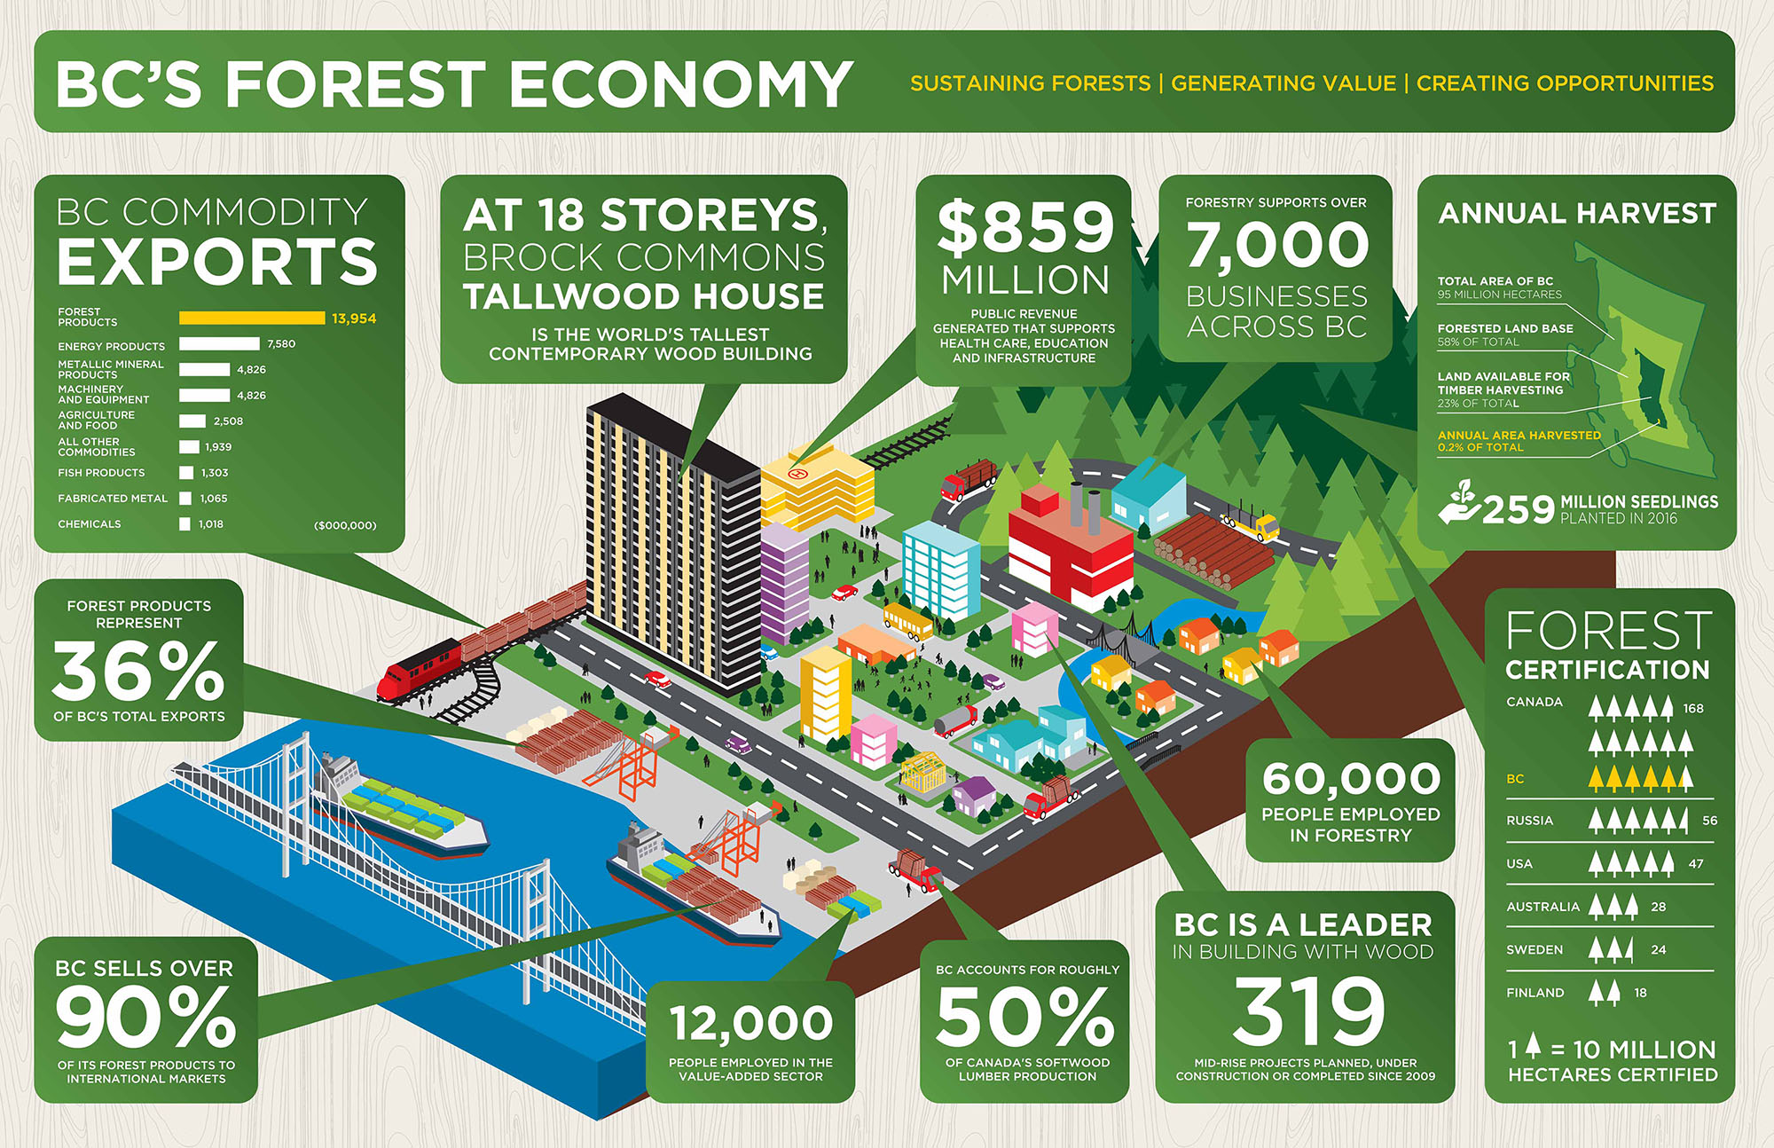
BC Forestry by the Numbers

Slide 19
Third-Party Certification
Three certification schemes in BC: FSC, CSA and SFI
BCTS is certified to the SFI Forest Management standard
SFI standard has 13 principles and 15 objectives
BCTS undergoes regular audits against the SFI standard and its Sustainable Forest Management Plan

Slide 20
Sustainable Forest Mgmt.
Where does BCTS fit into BC’s Sustainable Forest Management framework?
Step 1:
forest management objectives set through legislation and land use planning
Step 2:
inventory of timber and non-timber values present on the land base
Step 3:
development and implementation of operational plans to meet objectives
Step 4:
monitoring and review of plan implementation

Slide 21
Workshop Format and Intent.
Some suggested guidelines:
  Ask questions
  Provide opinion
  Respect and inclusiveness
Some suggested outcomes:
  APC recommendations to SCRD and BCTS
  Review and comment on BCTS Operating Plans

Slide 22
BCTS-SCRD
Forest Management Workshops
Overview of Forest Policy
February 6th, 2018

Slide 23
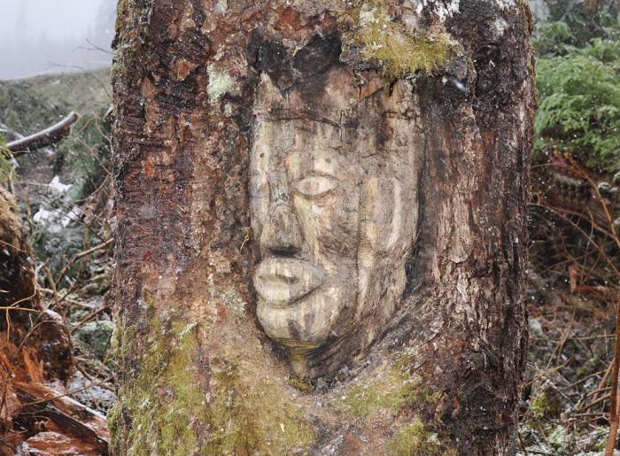
Timelines: pre-Colonial

Slide 24
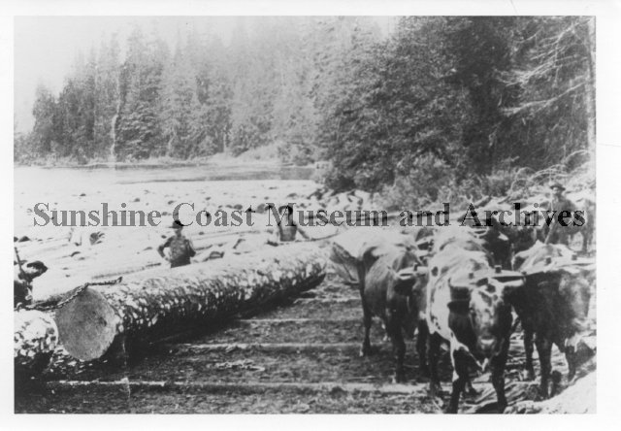
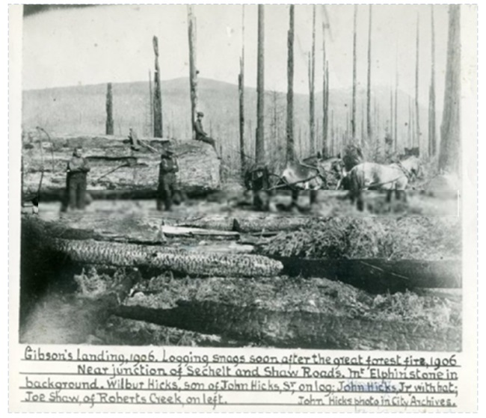
Early Logging: 1850s to 1909

Slide 25
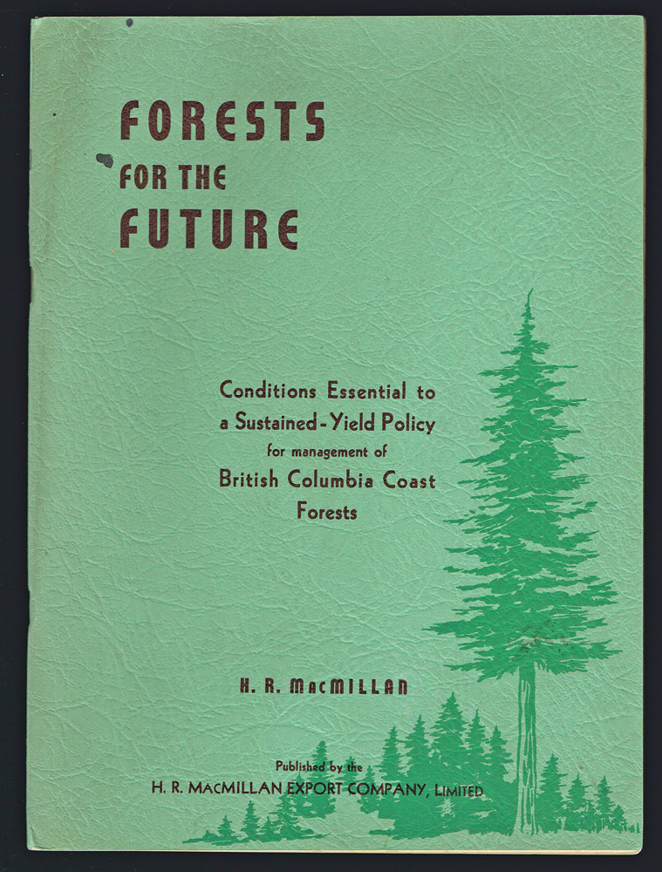
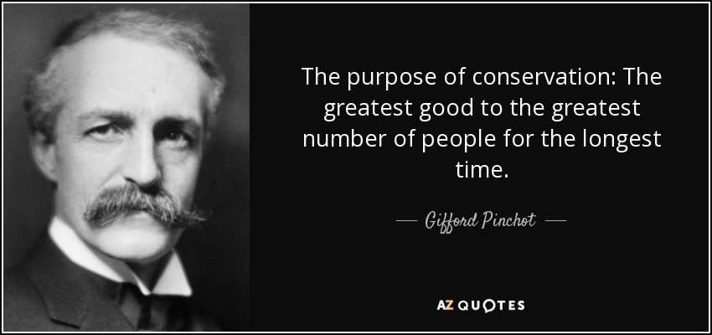
Fulton Comission: 1909

Slide 26
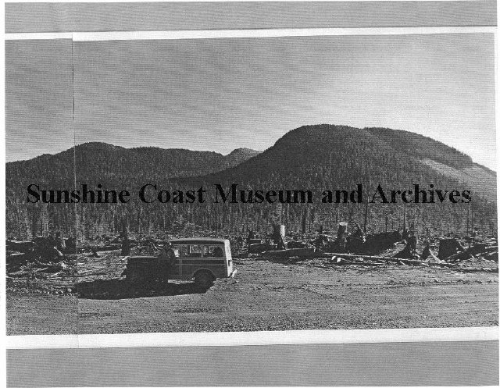
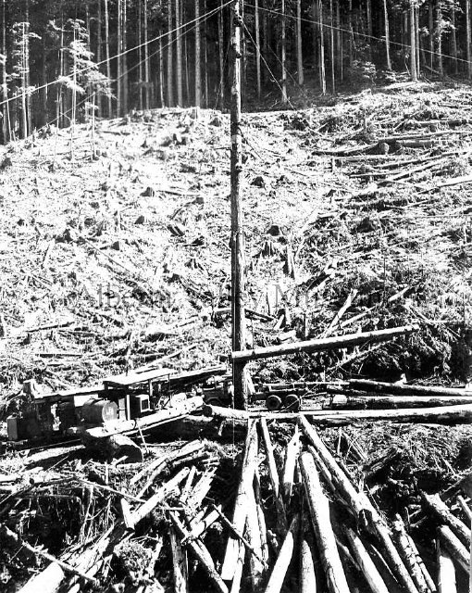
Sloan Comissions: 1945 and 1955

Slide 27

Video: Development of Sustained Yield (1975)

Slide 28
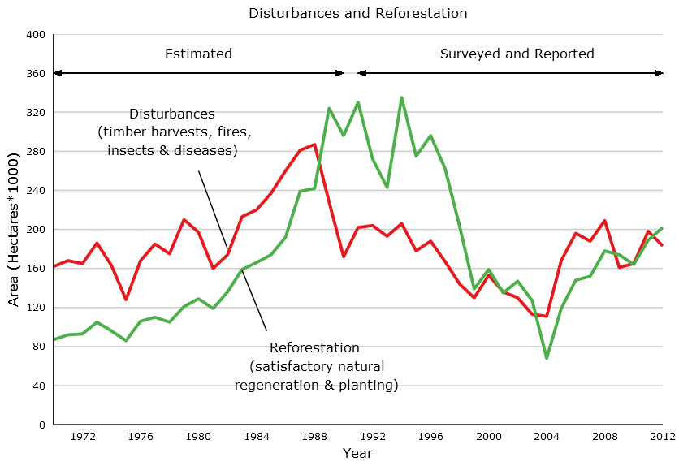
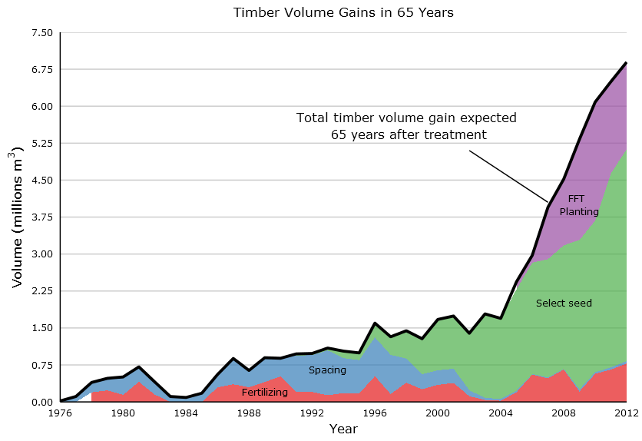
Pearse Commission: 1976

Slide 29
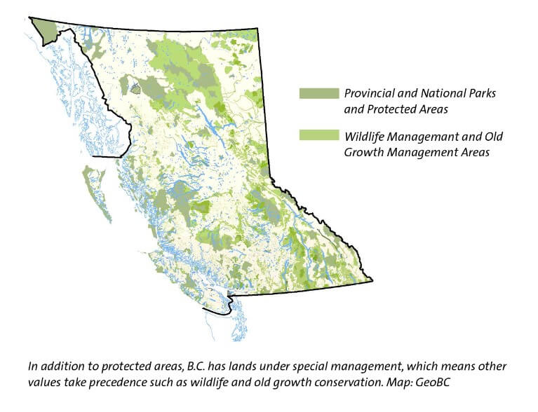
FRC, CORE and LRMP: 1990s

Slide 30
Existing Protected Areas on the Coast
14% of Sunshine Coast, Squamish and Chilliwack Forest Districts currently in parks and protected areas
12,200 Ha of park in SCRD
  6000 Ha Tetrahedron Park has some of the oldest undisturbed forests in Canada
  3000 Ha Spipiyus Park protects old-growth Douglas fir stands and some of the oldest yellow cedar, mountain hemlock and western hemlock in the world
5,800 Ha of protected old growth (park, OGMA, etc) in Howe and Chapman Landscape Units

Slide 31
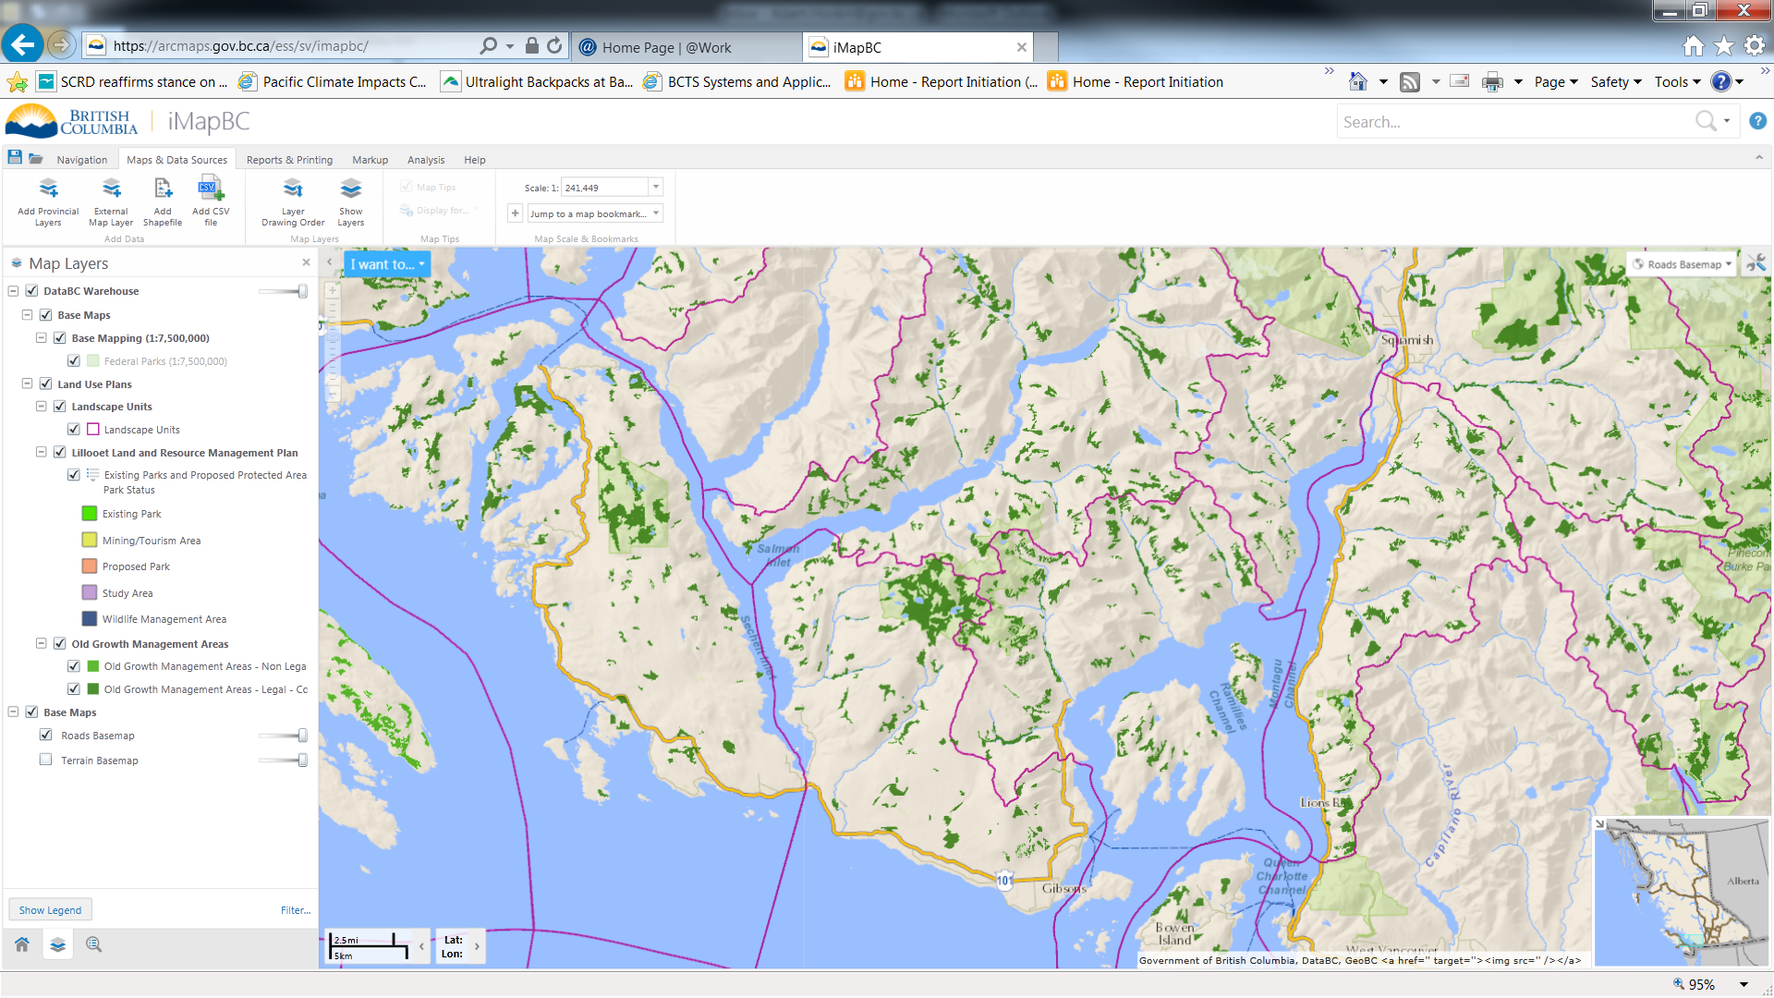
Howe
Landscape Unit
Chapman Landscape Unit

Slide 32
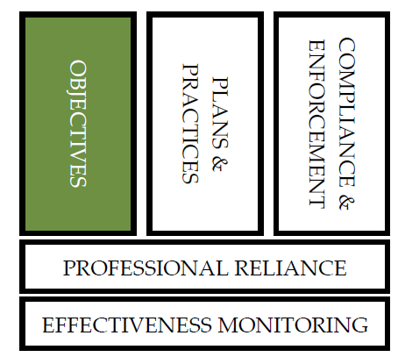
FRPA: Results-Based Code

Slide 33
FRPA Objectives
  Biodiversity
  Cultural Heritage
  Fish/riparian ecosystems
  Forage and associated plant communities
  Recreation
  Resource Features (e.g., limestone caves)
  Soils
  Timber
  Visual quality
  Water quality
  Wildlife

Slide 34
FRPA Objective: Water in Community Watersheds (FPPR sec. 8.2)
(1) In this section, "community watershed" means a community watershed:
(a) that is continued under section 180 (e) of the Act, and
(b) for which a water quality objective has not been:
(i) continued under section 181 of the Act, or
(ii) established under the Government Actions Regulation.
(2) The objective set by government for water being diverted for human consumption through a licensed waterworks in a community watershed is to prevent to the extent described in subsection (3) the cumulative hydrological effects of primary forest activities within the community watershed from resulting in:
(a) a material adverse impact on the quantity of water or the timing of the flow of the water to the waterworks, or
(b) the water from the waterworks having a material adverse impact on human health that cannot be addressed by water treatment required under:
(i) an enactment, or
(ii) the licence pertaining to the waterworks.
(3) The objective set by government under subsection (2) applies only to the extent that it does not unduly reduce the supply of timber from British Columbia's forests.
(4) If satisfied that the objective set out in subsection (2) is not required to provide special management the minister responsible for the Wildlife Act must exempt a person from the requirement to specify a result or strategy in relation to the objective.
(5) If satisfied that the objective set out in subsection (2) is addressed, in whole or in part, by an enactment, the minister responsible for the Wildlife Act must exempt a person from the requirement to specify a result or strategy in relation to the objective set out in subsection (2) to the extent that the objective is already addressed.

Slide 35
FRPA Plans and Practices
FRPA Strategic Plans (HLP) | LUP SRMP LRMP Landscape Unit Plans GAR Orders Section 7 Notices
FRPA Operational Plans | Forest Stewardship Plans Woodlot Licence Plans
Stand-level and Voluntary | Site Plans SFM Plans

Slide 36
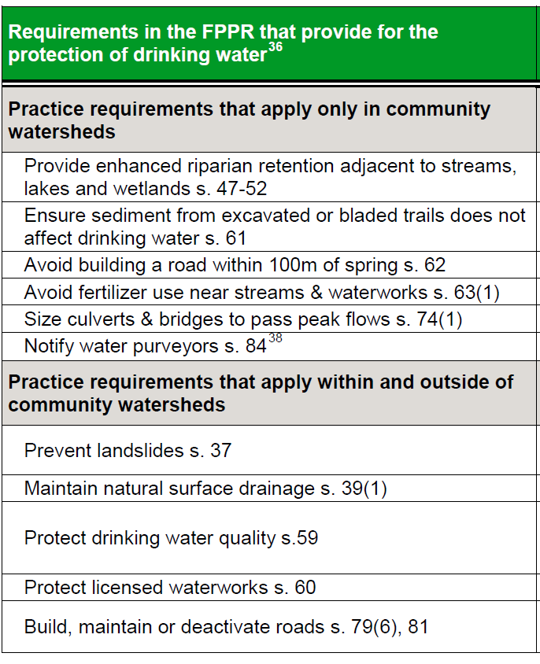
FRPA Practice Requirements: drinking water

Slide 37
FSP: Strategy Community Watersheds
The TSM will ensure that all primary Forest Activities are compliant with FPPR 59, 60, 61, 62 and 63. In addition, all primary forest activities within community watersheds authorized or conducted by the TSM will be consistent with the recommendations of a hydrologic assessment. The hydrologic assessment will:
be written by a Qualified Professional;
consider the potential for hydrologic changes, within the watershed, associated with climate change and industrial activities;
indicate that planned and existing harvesting and road building are unlikely to result in an elevated risk to a licenced waterworks associated with increased peak flows;
contain a survey of existing sediment sources that could impact a licenced waterworks;
assess riparian and channel conditions upstream of any licenced waterworks;
include a watershed report card; and
provide recommendations that mitigate the risk of the primary forestry activities impacting the objectives stated in FPPR 8.2.
In respect to community Watersheds, the TSM will work with other tenure holders within the relevant FDU to incorporate their planned and existing activities into the hydrologic assessment. The TSM will refer the completed hydrologic assessment to those tenure holders prior to the commencement of primary forest activities.

Slide 38
FRPA: C&E
C&E is the law enforcement Program of MFLNRORD. It’s role is to ensure that forestry laws are being followed in B.C.’s public forests and to take action where non-compliance occurs.
Non-compliance can be addressed by:
  Remediation orders
  Administrative penalties
  Suspended or canceled agreements
  Court action (violation tickets and prosecution)

Slide 39
Professional Reliance
Required knowledge, education, expertise and experience
Application of judgement and decision making coupled with accountability to the public
Specific rights and obligations
Adherence to legislation, regulation and policy established by the government

Slide 40
Video: Learn More About Professional Reliance (2016)

Slide 41
Effectiveness Monitoring
Forest Resource Evaluation Program
    Specific monitoring protocols for all FRPA objectives
Water Quality Monitoring Protocol:
  Methodology provides a means to randomly sample representative forestry and livestock disturbed sites, estimate fine sediment and determine if or how management could reduce that sediment

Slide 42
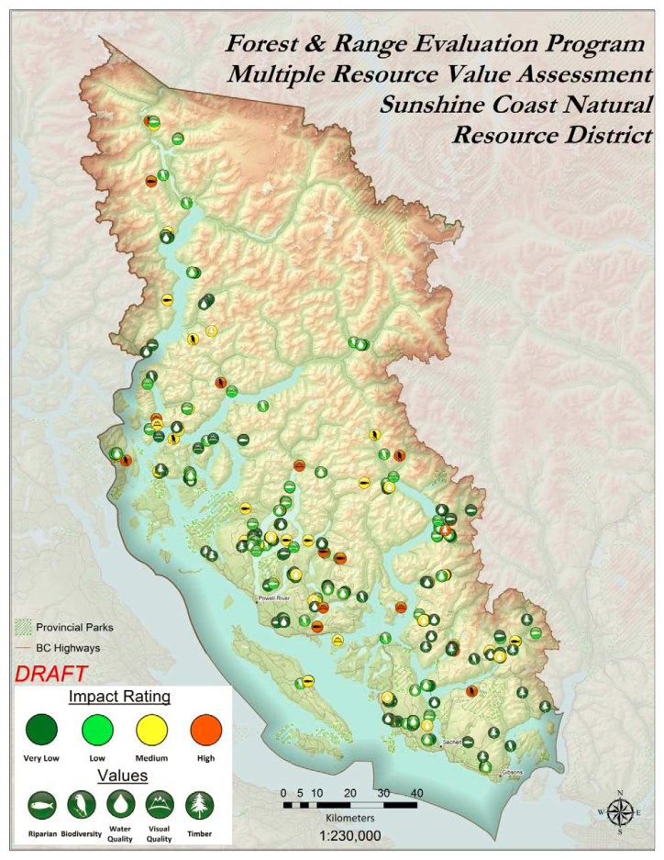
FREP Monitoring for Sunshine Coast NRD (DSC) (2014)
https://www2.gov.bc.ca/assets/gov/farming-natural-resources-and-industry/forestry/frep/frep-docs/mrva_sunshine_coast_district_-_final.pdf

Slide 43
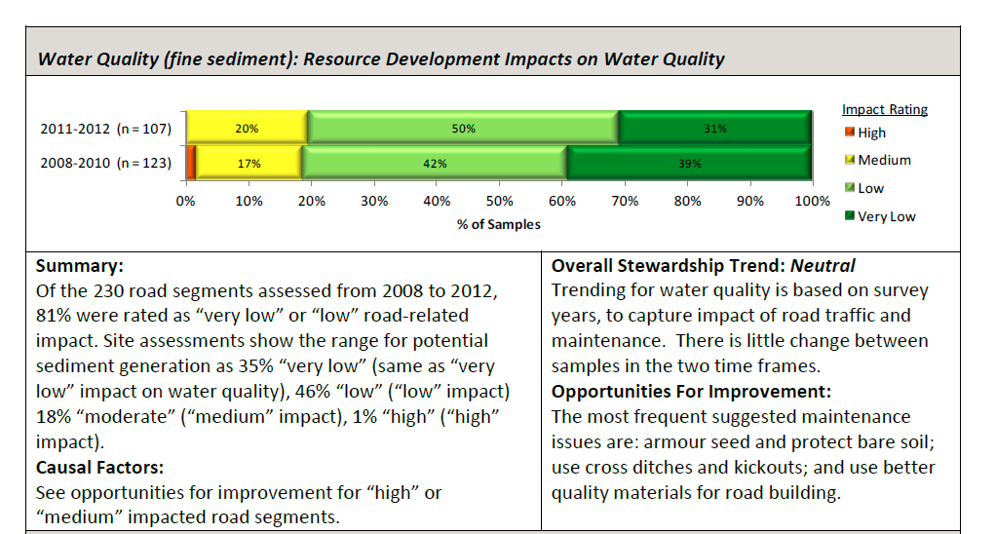
FREP Water Quality Monitoring for DSC

Slide 44
Timber Supply and
Annual Allowable Cuts
What is Timber Supply?
How do we determine cut levels?
Who gets to decide?
How is the Sunshine Coast doing?

Slide 45
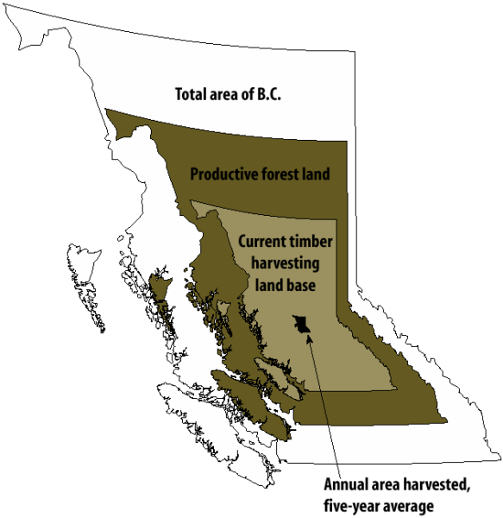
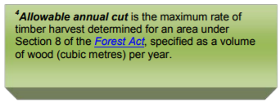

Timber Supply
Provincial Overview

Slide 46
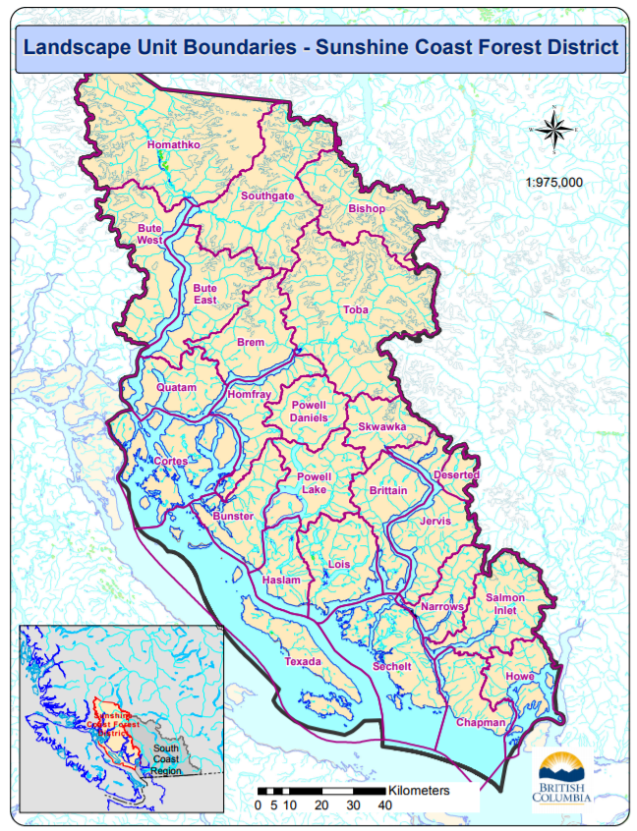
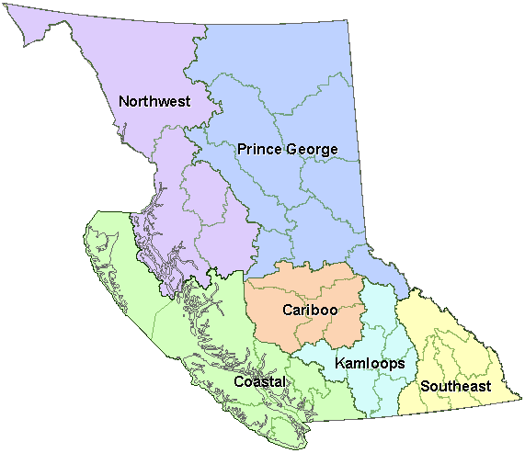
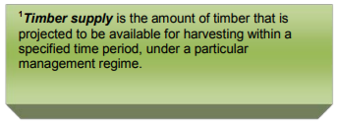
Timber Supply
Regions and LSUs

Slide 47
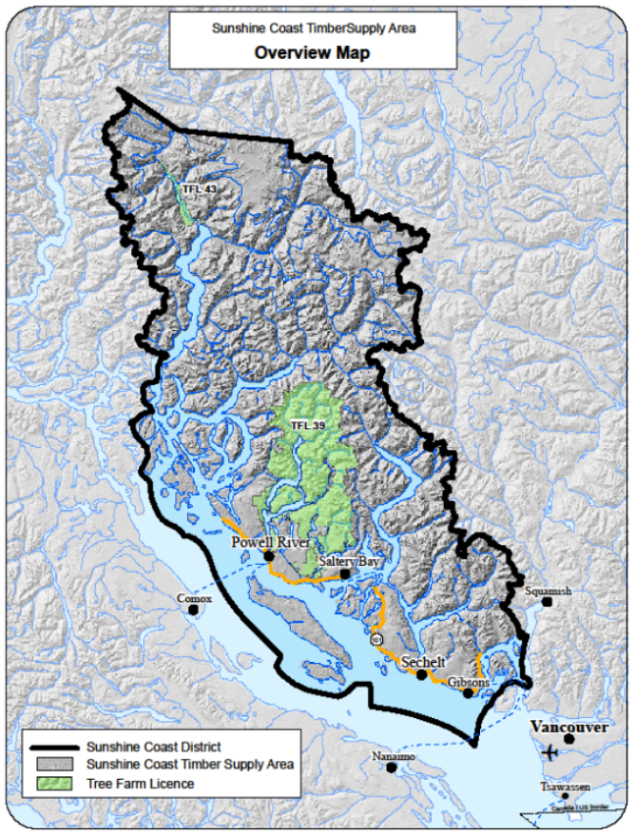
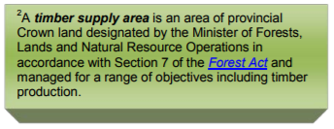
Timber Supply
TSAs
Sunshine Coast Timber Supply Area

Slide 48
Timber Supply
Review Considerations
Constraints
“Constraints” are areas set aside through legislation, land use planning or because they are not operable (e.g., no way to get a road there).
Timber Harvesting Land Base
The THLB is what is left after all constraints are considered
AAC
The AAC is set using rates of tree growth on the THLB

Slide 49
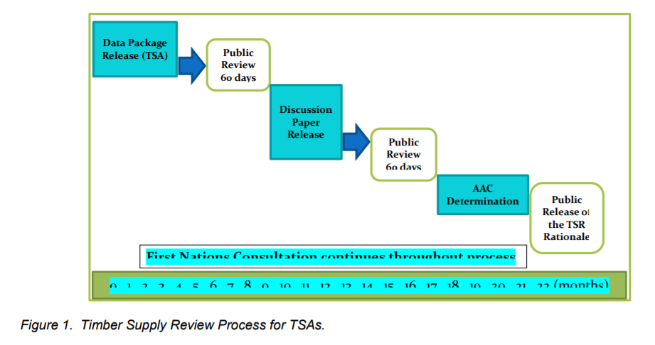
Timber Supply
ReviewProcess

Slide 50
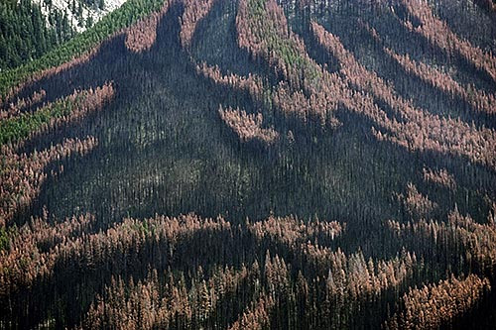
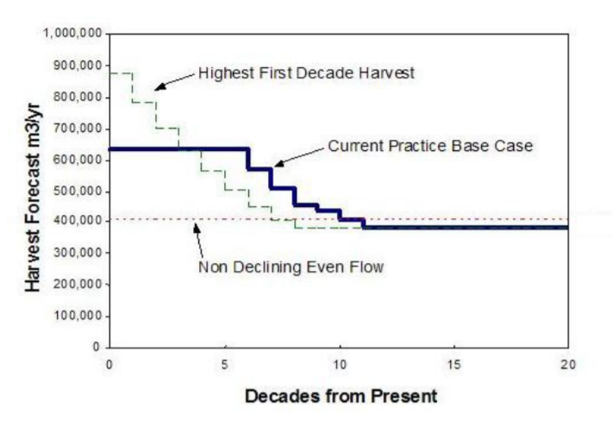
Timber Supply
Falldown
Technical Falldown can occur when actual harvest patterns do not mimic the assumptions in the timber supply models (e.g., avoiding contentious areas).

Slide 51
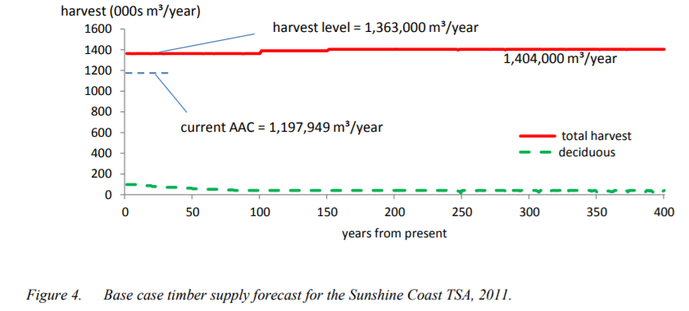
Timber Supply
Forecast for the Sunshine Coast

Slide 52
Timber Supply
Sunshine Coast Considerations
Site Productivity is considerably higher than estimated
Community Interface – reduced supply
Community Watersheds – harvest constraints
Scenic Areas – harvest constraints
Clean Energy Projects – transmission lines

Slide 53
Timber Supply and
Annual Allowable Cuts
What is Timber Supply?
How do we determine cut levels?
Who gets to decide?
How is the Sunshine Coast doing?

Slide 54
Video: Sustainable Forest Management in BC

Slide 55
Group Discussion
  Who’s forest is it anyways?
  How do we manage for multiple values in public forests?
  What role do professionals play?
  How do the complexities of statutory and non-statutory expectations feed decision-making?
  What is effective community engagement?
  How do jurisdictional boundaries and scope impact forest management?
  What can we do to prevent conflict?
  How do we create and maintain social licence?
  What do you want from your forest and can you have it all?
  Your thoughts and questions?

Slide 56
Next sessions
Session 1: Forest Management and Forest policy in BC
7:00 pm to 9:00 pm; Tuesday, February 6th, 2018
SCRD Offices
Session 2: BCTS Information Sharing and Public Engagement
7:00 pm to 9:00 pm; Monday, March 12th, 2018
SCRD Offices
Session 3: Forest Planning – a Boots on the Ground Approach (bring lunch, sturdy footwear, rain gear, a vheicle, etc)
10:00 am to 3:00 pm; Saturday, April 21st, 2018
B&K Kiosk

Slide 57
The End

